Slide 1
SIT323 Cloud Application Development
Class 3 – Assertions and Unit Testing

Slide 2
Content
Introduction
Preconditions
Postconditions
Implementation
Assertions
C# Implementation of Assertions
Unit Testing
Summary

Slide 3
Introduction
Consider transferring $1000
from bank account A to account B.
Are the conditions before the transfer the same as those conditions after the transfer?
Clearly, in many cases, the before and after conditions differ.

Slide 4
Preconditions
are the conditions that must be met immediately before a method starts.
refer to what the method is expecting.
if any precondition is false, the results of that method are said to be undefined.

Slide 5
Postconditions
are the conditions that must be met immediately after a method ends.
refer to what the method must achieve.
if any postcondition is false, that method has failed to carry out its task.

Slide 6
Implementation
Pre and postconditions are implemented in programming languages using:
IF statements
assertions (if available)
language specific statements (if available).

Slide 7
Assertions
An assertion is a condition where it’s value is always expected to be true.
If the value of a program assertion is true, that program is assumed to be correct to that point.
If the value of a program assertion is false, there is something wrong with that program.

Slide 8
Assertions
A program can contain many assertions.
Assertions can be placed:
at the start of a method for preconditions
just before invoking a method for preconditions
at the end of a method for postconditions
just after invoking a method for postconditions
between the start and end of a method

Slide 9
Adding two time values (hh:mm:ss) - Example
time 1 = 10 : 30 : 30
time 2 = 3 : 40 : 30
The addition is:
10 : 30 : 30
+ 3 : 40 : 30
= 14 : 11 : 00

Slide 10
Adding two time values (hh:mm:ss) – An algorithm
AddTimes(t1, t2, t3)
// compute seconds
sec = t1.sec + t2.sec
IF sec >= 60 THEN
sec = sec – 60
m = 1
ELSE
m = 0
ENDIF
// compute minutes
min = t1.min + t2.min + m
IF min >= 60 THEN
min = min – 60
h = 1
ELSE
h = 0
ENDIF
// compute hours
hr = t1.hr + t2.hr + h
IF hr >= 24 THEN
hr = hr – 24
ENDIF
// store results
t3.sec = sec
t3.min = min
t3.hr = hr
END

Slide 11
Adding two time values (hh:mm:ss)
Preconditions
What pre-conditions can you think of?
0 <= t1.sec < 60
0 <= t1.min < 60
0 <= t1.hr < 24
0 <= t2.sec < 60
0 <= t2.min < 60
0 <= t2.hr < 24

Slide 12
Adding two time values (hh:mm:ss)
Postconditions
What post-conditions can you think of?
0 <= t3.sec < 60
0 <= t3.min < 60
0 <= t3.hr < 24
t1 did not change
t2 did not change
t3.sec = (t1.sec + t2.sec) mod 60
t3.min = ((t1.sec + t2.sec) / 60 + t1.min + t2.min) mod 60
t3.hr = (((t1.sec + t2.sec) / 60 + t1.min + t2.min) / 60 + t1.hr + t2.hr) mod 24
6, 7 and 8 could be another way of writing the algorithm.

Slide 13
Where would you place assertions?
AddTimes(t1, t2, t3)
// compute seconds
sec = t1.sec + t2.sec
IF sec >= 60 THEN
sec = sec – 60
m = 1
ELSE
m = 0
ENDIF
assert(0 <= sec < 60)
assert(0 <= m <= 1)
// compute minutes
min = t1.min + t2.min + m
IF min >= 60 THEN
min = min – 60
h = 1
ELSE
h = 0
ENDIF
assert(0 <= min < 60)
assert(0 <= h <= 1)
Recall that assertions can be placed anywhere.
// compute hours
hr = t1.hr + t2.hr + h
IF hr >= 24 THEN
hr = hr – 24
ENDIF
assert(0 <= hr < 24)
// store results
t3.sec = sec
t3.min = min
t3.hr = hr
END

Slide 14
C# Implementation of Assertions
See “Class 3 - Assertions”
System.Diagnostics.Debug
using System.Diagnostics;
Debug.Assert( … );
Run in Debug mode
Run in Release mode (What happens?)

Slide 15
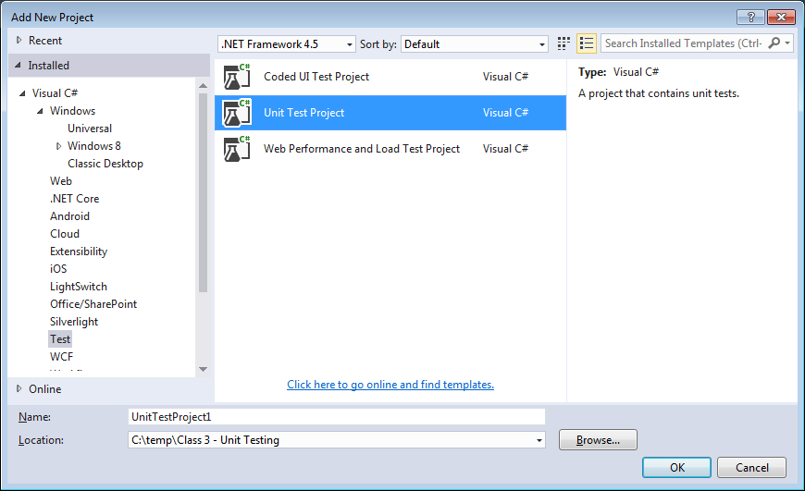
Unit Testing - Visual Studio
Open a Solution
Add a new Unit Test Project

Slide 16
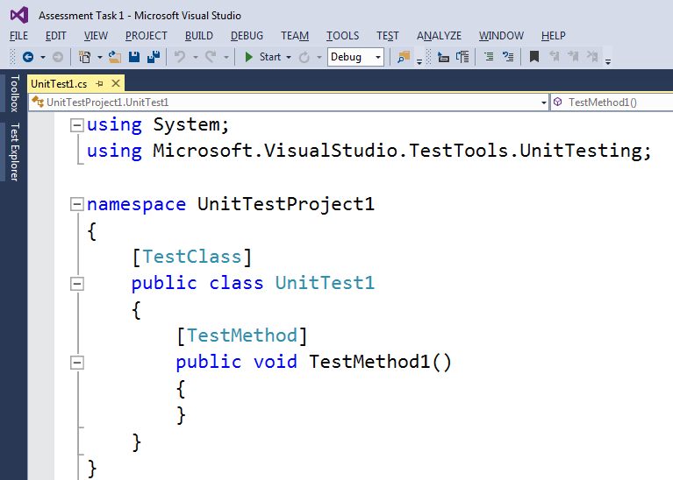
Unit Testing - Visual Studio
A test class and a test method are generated.

Slide 17
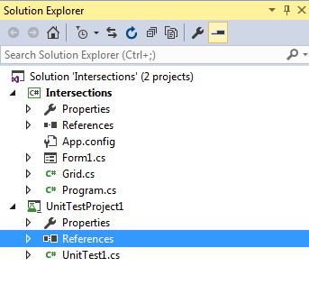
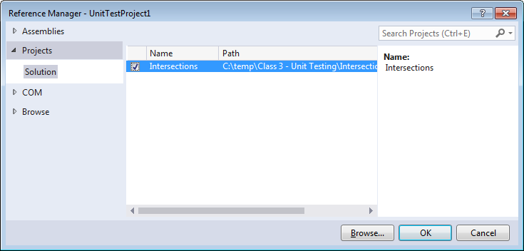
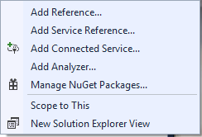
Unit Testing - Visual Studio
Add a reference from your Unit Test project to the other project in your solution.

Slide 18
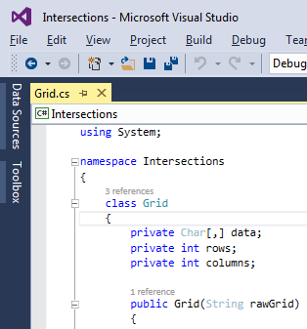
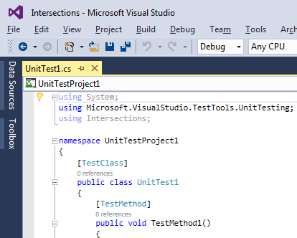
Unit Testing - Visual Studio
Add a using statement to your test file.

Slide 19

Unit Testing - Visual Studio
Ensure the class being tested is public.

Slide 20
Unit Testing - Visual Studio
Write your test code within each test method using the AAA pattern.
Arrange
prepare object/values for the method being tested
prepare expected objects/values
Act
call the method being tested
Assert
check that the method worked as expected

Slide 21
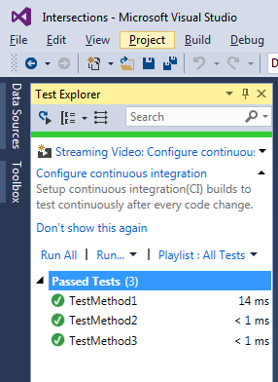
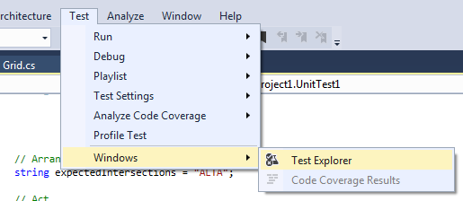
Unit Testing - Visual Studio
Use Test Explorer to run your tests, e.g., select Run All

Slide 22
Unit Testing - Visual Studio
See code example Class 3 - Unit Testing
TestMethod1 checks a 2D grid (size and data).
TestMethod2 identifies intersections.
TestMethod3 identifies intersections of another grid.

Slide 23
Unit Testing - Visual Studio
Some MSDN Reading
Unit Test Basics
https://msdn.microsoft.com/en-au/library/hh694602(v=vs.120).aspx
Creating and Running Unit Tests
https://msdn.microsoft.com/en-us/library/ms182532(v=vs.120).aspx

Slide 24
Summary
Pre-conditions specify what must be true just before a method commences.
Post-conditions specify what must be true at the end of a method.
Assertions specify what must be true at particular places midway through a method.
Some real programming languages support these concepts, and some do not.
Unit Testing in Visual Studio

Slide 25
Assessment
For your Assessment Task 1, you are expected to design and implement many Unit Tests.
SIT323 - Deakin University - 2018
Page 25

